Slide 1
WEATHER PRECIPITATION PREDICTION
by Sathwik Reddy

Slide 2
INTRODUCTION
Predicting weather patterns has become increasingly crucial in recent years due to the rising impacts of climate change and extreme weather events. This project focuses on developing a predictive model for precipitation using machine learning techniques, specifically the K-Nearest Neighbors (KNN) and Naive Bayes algorithms, implemented in the R programming language.
The K-Nearest Neighbors algorithm, a non-parametric and instance-based learning method, makes predictions based on similarity between data points, which is particularly useful for handling nonlinear relationships in weather data.
Meanwhile, Naive Bayes, a probabilistic classifier, leverages conditional probability to model the likelihood of precipitation based on various meteorological factors.
By comparing the effectiveness of these two algorithms, this project aims to evaluate and identify the strengths and limitations of each approach in predicting precipitation. The insights derived from this research can enhance meteorology's predictive accuracy and inform more reliable weather forecasting systems.

Slide 3
METHODOLOGY
Data Collection:
The dataset used in this project is sourced from Kaggle, a popular platform for data science and machine learning datasets. Kaggle provides various weather datasets from various reliable sources, such as government meteorological departments and global weather stations. For this project, we selected a dataset that includes historical weather data with features such as temperature, humidity, wind speed, pressure, and precipitation levels.
Data Preprocessing Steps Used:
Splitting the dataset
Handled missing values using the omit function
Removed Duplicate Values from the dataset
Normalizing the dataset columns using the scale function
Encoded Categorial Precip.Type Column with factor

Slide 4
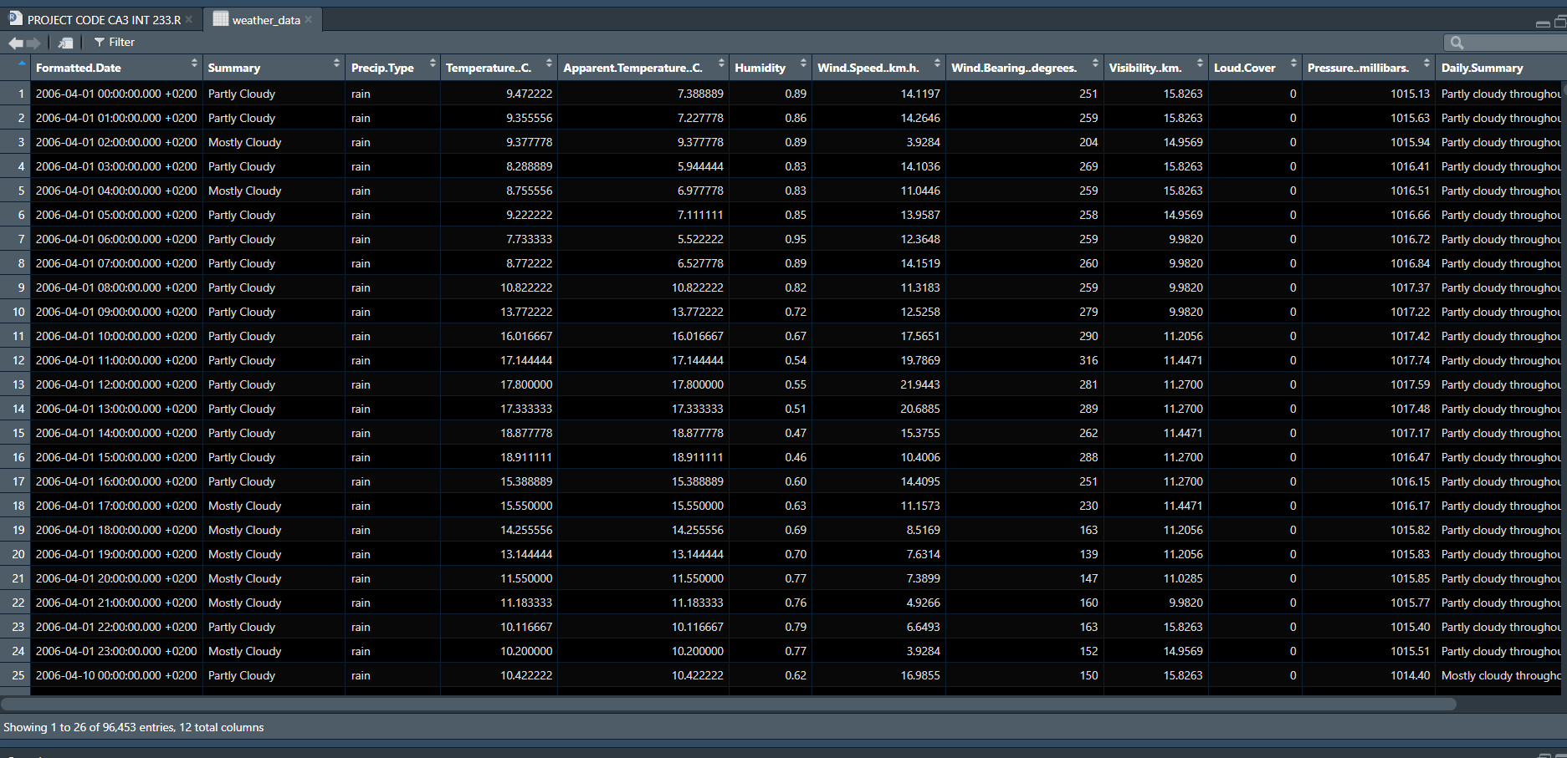
WEATHER DATASET:

Slide 5
PREVIOUS DRAWBACKS OF THIS PROJECT:
Accuracy
Handling of null and duplicate values
No proper Visualization of results
Partition of data
OBJECTIVES OF THIS PROJECT:
Predicting Precipitation type
Comparing algorithms
Improving model accuracy
Providing actionable insights
Evaluating model performance

Slide 6
Implementation in R:
Libraries Used:
The project was carried out in the R programming language, which is commonly used for data analysis and machine learning. The following libraries were used:
class: This library was used to implement the K-Nearest Neighbors (KNN) algorithm for classification.
e1071: This library provided the tools to implement the Naive Bayes classifier.
caret: This package helped with data partitioning, model training, and evaluation.
ggplot2: This library was used for creating visualizations to better understand the data and results.
Partition of data:
The dataset was split into two parts: 80% for training and 20% for testing. The training set, which includes 80% of the data, was used to help the models learn patterns in the weather features. The remaining 20% was reserved as a test set to evaluate the models’ accuracy and ensure they perform well on new, unseen data. This 80-20 split is a standard approach to balance model learning and testing accuracy.

Slide 7
Implementation of KNN and Naïve Bayes:
How Naive Bayes Works:
Bayes' Theorem: Naive Bayes calculates the probability of each class given the features and selects the class with the highest probability.
Assumption of Independence: It assumes that the features are independent (this is why it’s called “naive”), which makes it easier to compute the probabilities.
Training the Model: During training, the algorithm calculates the probability of each feature for each class.
Prediction: For a new data point, the model computes the probability of each class and predicts the class with the highest probability.
How KNN works:
Choose K: Select the number of neighbors (K) to consider. A common choice is K=5, but this can be adjusted.
Calculate Distance: For each point in the dataset, calculate its distance to the new data point. The most common distance measure is Euclidean distance.
Find Nearest Neighbors: Identify the K nearest data points to the new point.
For Classification: The new point is assigned the most common class label among the K neighbors.
For Regression: The prediction is the average of the values of the K nearest neighbors.
Evaluate the Model: Use accuracy or other metrics to check how well the model performs.

Slide 8
Model Evaluation:
Evaluation of KNN:
To evaluate how well a KNN model performs, we can use a few key metrics:
Accuracy:
This is the most common metric. It shows the percentage of correct predictions.
Confusion Matrix:
This shows how many predictions were correct and how many were wrong for each class.
Precision, Recall, and F1-Score:
Precision is the percentage of correct positive predictions out of all positive predictions.
Recall is the percentage of actual positives that were correctly predicted.
F1-Score is the balance between precision and recall.
Cross-Validation:
This is used to test the model's performance on different subsets of data to get a better idea of how it will perform on new data.

Slide 9
Comparison of Results:
Comparing the Accuracies of both algorithms:
The performance of the K-Nearest Neighbors (KNN) and Naive Bayes algorithms can be compared based on their accuracy scores. In this case:
KNN Accuracy: 98.57%
Naive Bayes Accuracy: 95.91%
As we can see, KNN has a slightly higher accuracy compared to Naive Bayes, indicating that KNN performed better in predicting the correct outcomes for this dataset. However, the difference in accuracy is relatively small, and both models perform well.
Comparing Predictions:
KNN Predictions: KNN classifies a new data point based on the majority class of its K nearest neighbors. It uses distance metrics to find the most similar data points and makes predictions accordingly.
Naive Bayes Predictions: Naive Bayes, based on Bayes' Theorem, calculates the probability of each class for a new data point and predicts the class with the highest probability. It assumes that the features are independent of each other.
KNN is more sensitive to the local structure of the data, meaning it might predict differently if the nearby data points change.
Naive Bayes works well even with independent features and may be less affected by noise compared to KNN.

Slide 10
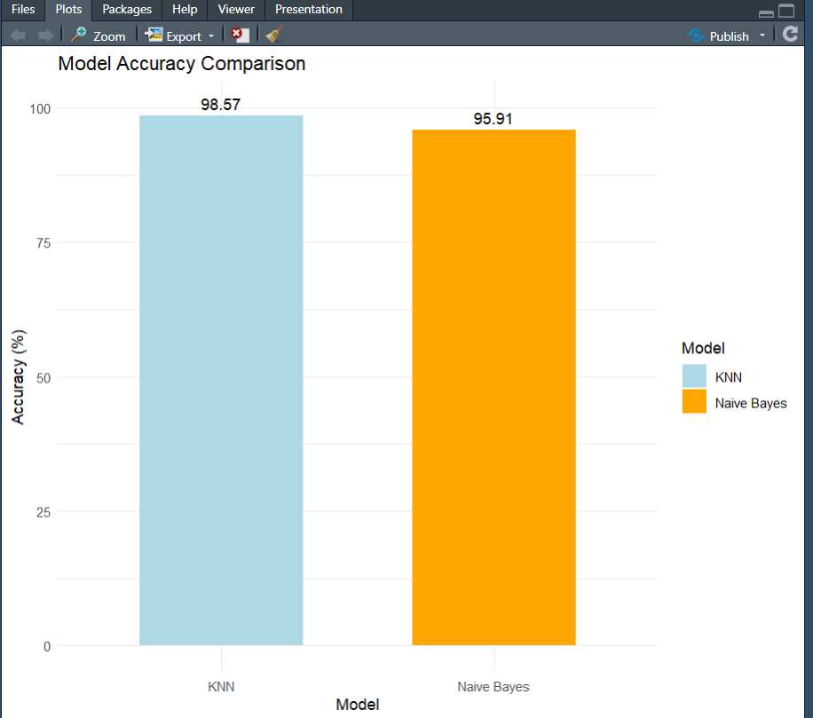
Accuracy Results:

Slide 11
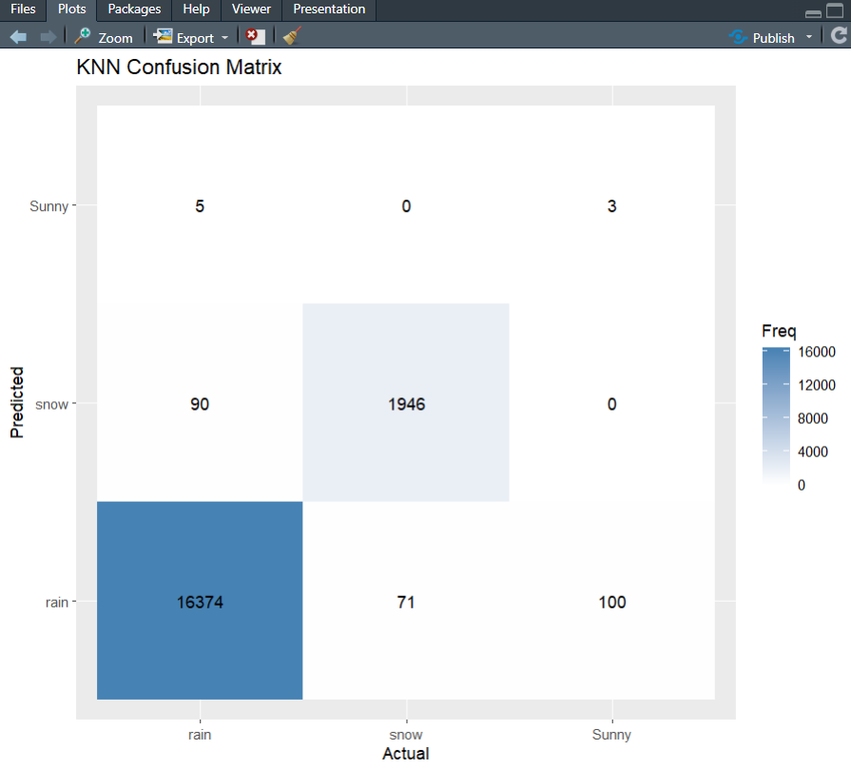
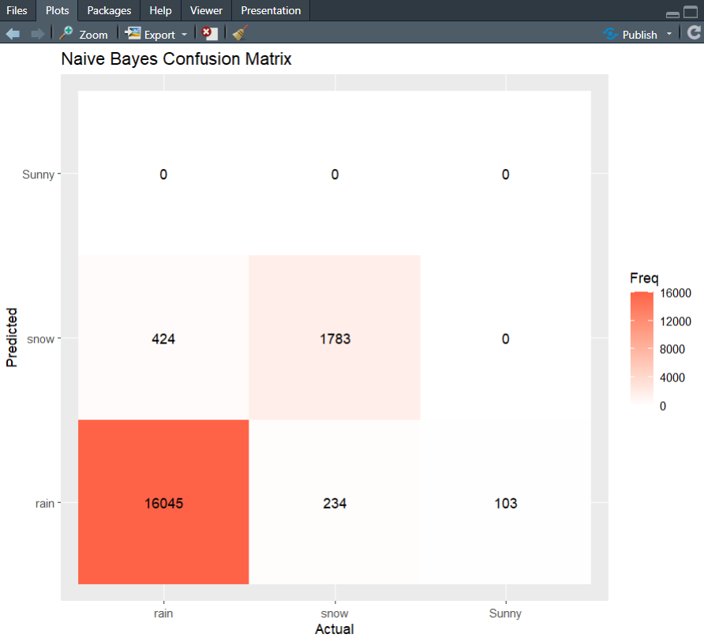
Confusion matrix prediction Results:

Slide 12
Applications of this project:
Agriculture sector
Disaster Management
Water Resource Management
Transportation

Slide 13
CONCLUSION:
In this project, we applied the K-Nearest Neighbors (KNN) and Naive Bayes algorithms to predict precipitation types based on historical weather data, focusing on features like humidity, temperature, wind speed, and precipitation type. Both models were trained using the data and then evaluated using test data to assess their predictive accuracy.
KNN Model: The KNN model performed well, showing good accuracy in predicting precipitation types. The performance varied with different values of k, and choosing the right number of neighbors was crucial for balancing model sensitivity and generalization.
Naive Bayes Model: The Naive Bayes model was quick and efficient, providing a solid baseline for predicting precipitation. It handled the categorical feature (precipitation type) well and showed reasonable accuracy, especially with the use of Laplace smoothing to avoid zero probabilities.
Key Insights
Feature Importance: Humidity, temperature, and wind speed were significant factors in predicting precipitation. These features had a strong influence on the models' performance, highlighting the importance of accurate weather data for making predictions.
Model Comparison: The KNN model showed more sensitivity to the data, especially when choosing the right K, while Naive Bayes was faster and simpler but slightly less flexible. Both models had strengths in different areas, with KNN performing better in capturing local patterns and Naive Bayes excelling in handling categorical data.
Prediction Accuracy: Both models showed reasonable accuracy, with Naive Bayes being faster to train and easier to interpret, while KNN required more careful tuning but offered higher flexibility in prediction.

Slide 14
REFERENCES:
The implementation of the code for this project was built using a combination of previous classroom code and resources from Kaggle for the dataset. Kaggle provided a comprehensive weather dataset, which was essential for training and testing the models. The dataset included important weather features like humidity, temperature, and wind speed, which were used to predict precipitation types.
For visualizations, online resources, and websites were utilized to create the plots. These tools helped in visualizing model performance and understanding the relationships between the weather features and precipitation.
These resources were crucial in enabling the development, training, and evaluation of the models, as well as providing insights through visualizations.
DATASET: https://www.kaggle.com/datasets/muthuj7/weather-dataset

Slide 15
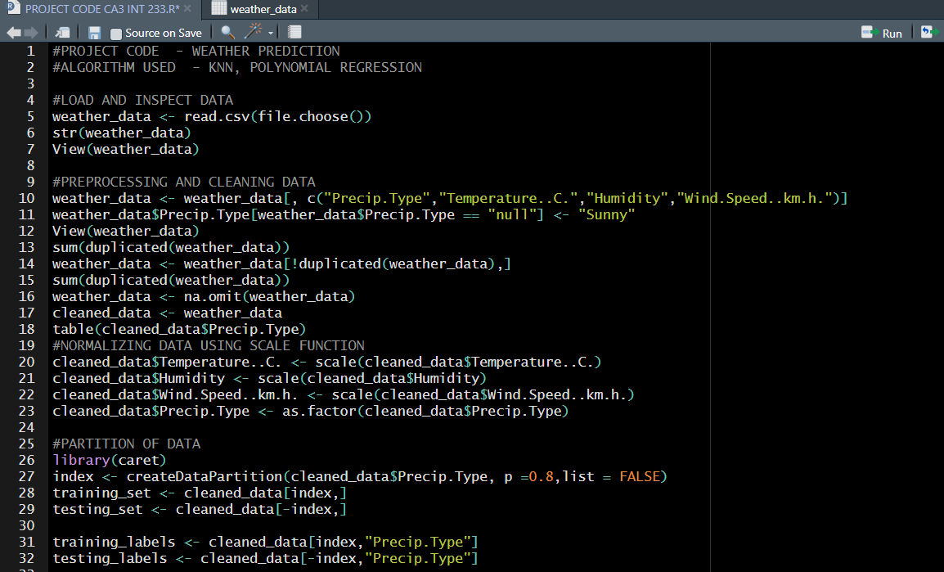
Appendices :
R CODE:

Slide 16
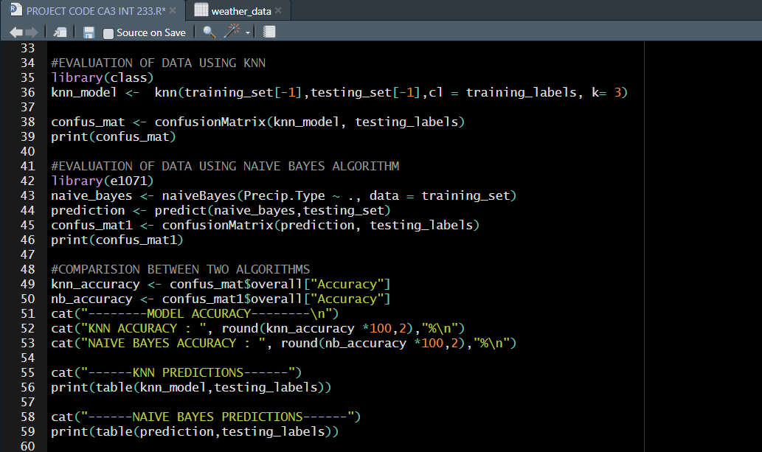

Slide 17
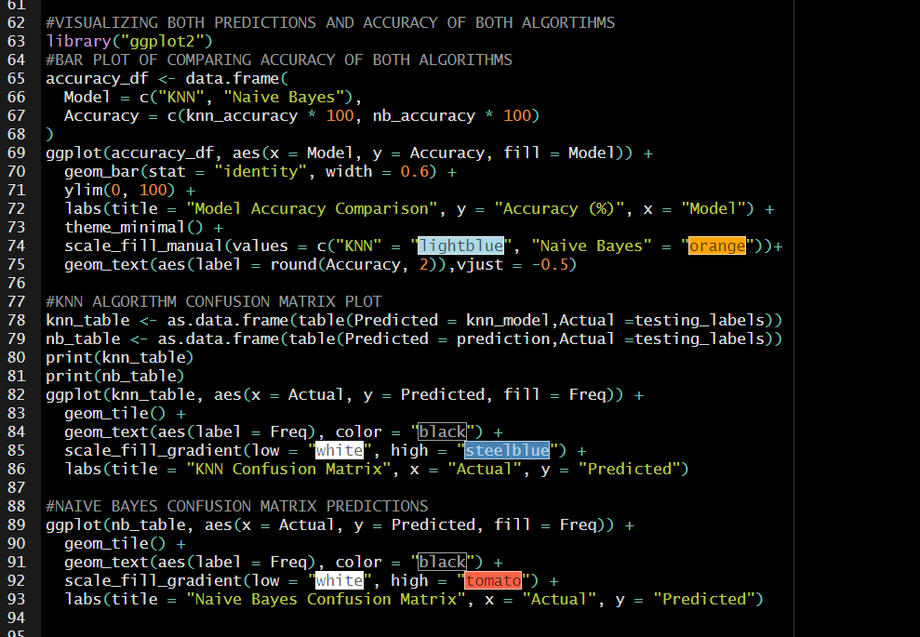

Slide 18
THANK YOU

